Slide 1

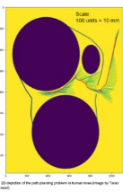
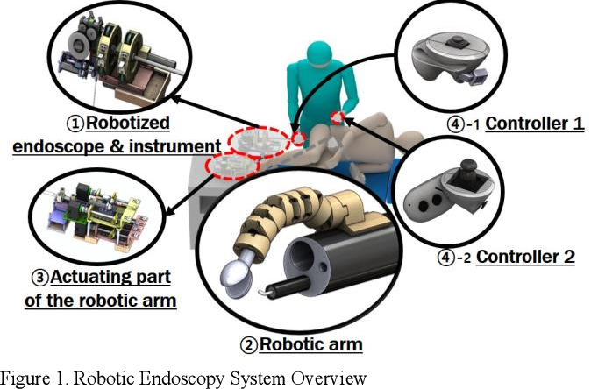
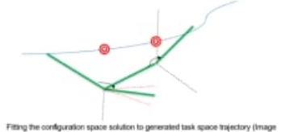
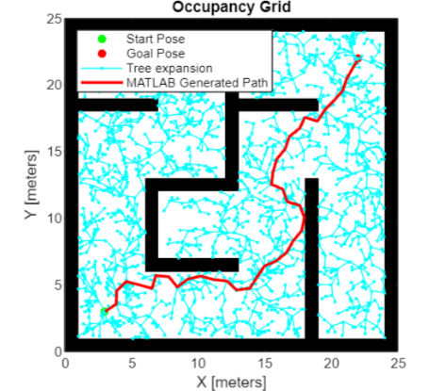
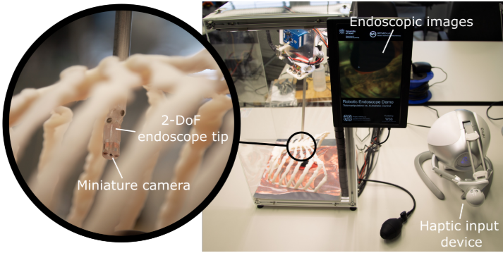
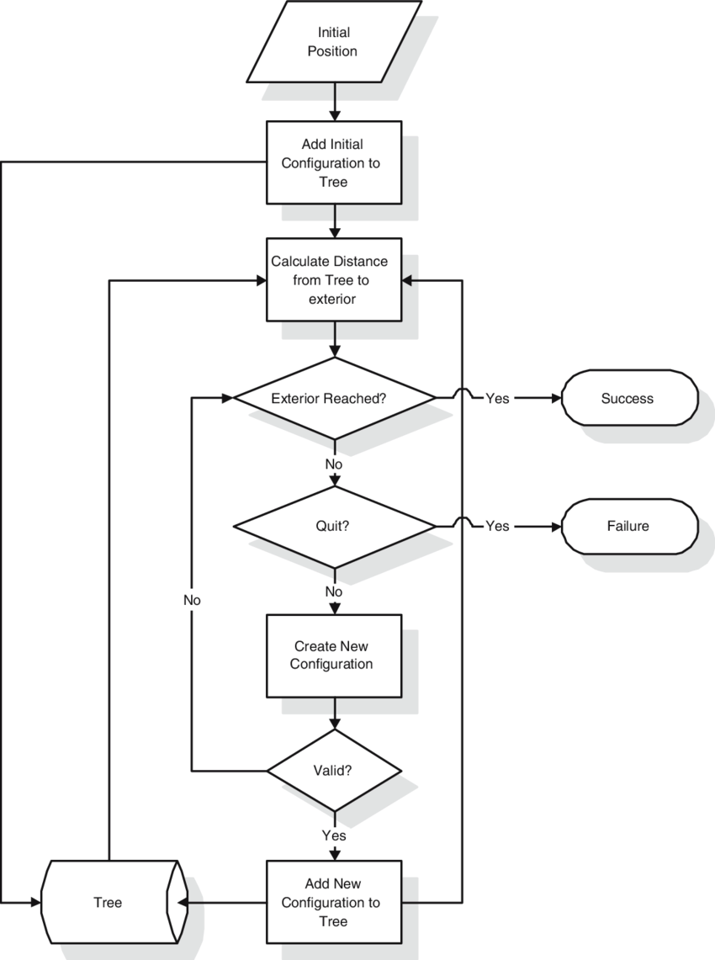
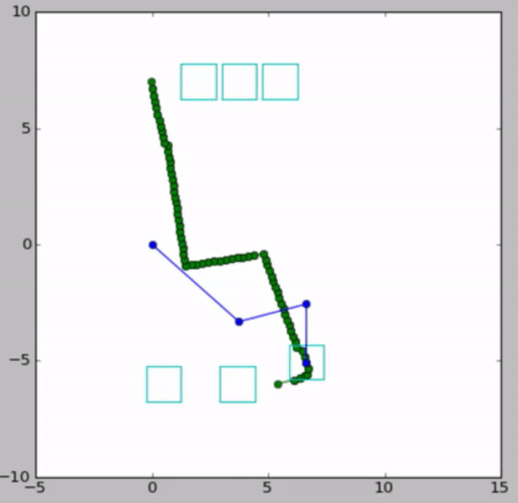
Shared control of robotic endoscope
ME 696 – Biomedical Devices and Systems
r.ashlesha@iitg.ac.in, s.shiv@iitg.ac.in
Ashlesha Ramteke
234103003
Shiv Pratap Singh
234103008
Introduction
The Rapidly-exploring Random Tree (RRT) algorithm is a popular method for path planning in robotics,
including applications like robotic endoscopes. Here's a simplified explanation of how it works:
Initialization: Start with a tree containing only the initial configuration of the robotic endoscope.
Expansion: Repeat until a certain condition is met (e.g., a specified number of iterations or until the
goal is reached):
Randomly sample a point in the configuration space.
Find the nearest node in the existing tree to the sampled point.
Generate a new node by taking a step from the nearest node towards the sampled point, ensuring
that it respects the constraints of the robotic endoscope's motion (e.g., avoiding obstacles).
If the new node is collision-free, add it to the tree and connect it to its nearest neighbor.
Termination: Stop when the goal is reached or a specified number of iterations is reached.
Path extraction: Once the algorithm terminates, the path from the initial configuration to the goal configuration can be extracted by backtracking from the goal node to the initial node along the tree edges.
Robotic endoscopes have transformed minimally invasive medical procedures by offering enhanced maneuverability and visualization capabilities compared to traditional endoscopes. However, operating these devices in complex anatomical environments remains a challenge. Shared control, which combines inputs from both the clinician and the robotic system, has emerged as a promising approach to address this challenge.
Technical Gap and objective
The existing literature on path planning for a hyper-redundant robotic endoscope in narrow passages of the human knee has highlighted the inadequacies of sampling-based algorithms. Previous work demonstrated the limitations of top-down approaches like IK and null space search. This project aims to address these challenges by proposing a bottom-up approach for configuration space solutions, while leveraging the effectiveness of a task space planner based on Rapidly-exploring Random Trees (RRT)
Results
Proposed solution
The results of the project will include comprehensive insights into the performance of the shared control system with integrated path planning capabilities:
Visualization of the RRT path planning process, providing a clear understanding of how the algorithm explores the configuration space and generates feasible paths.
Confirmation messages indicating whether the goal configuration was successfully reached within the specified constraints or if the maximum number of iterations was exceeded.
The proposed solution integrates shared control of robotic endoscopes with advanced path planning algorithms to overcome the limitations of current manual and automated systems. By combining human expertise with machine precision, the system aims to optimize procedural outcomes while minimizing operator workload and potential errors. This hybrid approach allows for real-time collaboration between the operator and the automated system, enabling dynamic adjustments to navigate complex anatomical structures effectively. The proposed solution entails implementing the Rapidly-exploring Random Tree (RRT) algorithm for path planning of the robotic endoscope.
Conclusion
In conclusion, this study highlights the critical need for an optimized configuration space planner that strikes a delicate balance between providing instantaneous solutions while ensuring the exploration of collision-free zones. The disparity between the success rates of the task space planner and the configuration space planner underscores the complexity of navigating narrow passages within the human knee.
Design Approach/Methodology
References
He, Yucheng, et al. "Endoscopic path planning in robot-assisted endoscopic nasal surgery." IEEE Access 8 (2020): 17039-17048.
Rilk, M., Wahl, F.M., Eichhorn, K.W.G., Wagner, I., Bootz, F. (2009). Path Planning for Robot-Guided Endoscopes in Deformable Environments. In: Kröger, T., Wahl, F.M. (eds) Advances in Robotics Research. Springer, Berlin, Heidelberg. https://doi.org/10.1007/978-3-642-01213-6_24
Ruiter, J. G., et al. "Robotic control of a traditional flexible endoscope for therapy." Journal of robotic surgery 7 (2013): 227-234.
Xiong, L., Chng, C. B., Chui, C. K., Yu, P., & Li, Y. (2017). Shared control of a medical robot with haptic guidance. International journal of computer assisted radiology and surgery, 12, 137-147.
Acknowledgement
We would like to express our sincere gratitude to all individuals and organizations who contributed to the success of this project. Special thanks to Professor S. Kanagaraj, whose expertise and support were invaluable throughout the development and implementation of the hearing and speech assistive devices.

